Slide 1

Love of Lego
Research on extrinsic motivation factors
Team members: Narine, Mark
Course: Design and Analysis of Experiments
Instructor: H. Madoyan
Notes:
Hi everyone, we are going to present you our Love of Lego project, in which we have tried to understand which extrinsic factors motivates employees
To work more productively or the opposite. The research is based on data collected by experimental survey. Our experiment’s participants have assembled
lego models in two different situations

Slide 2
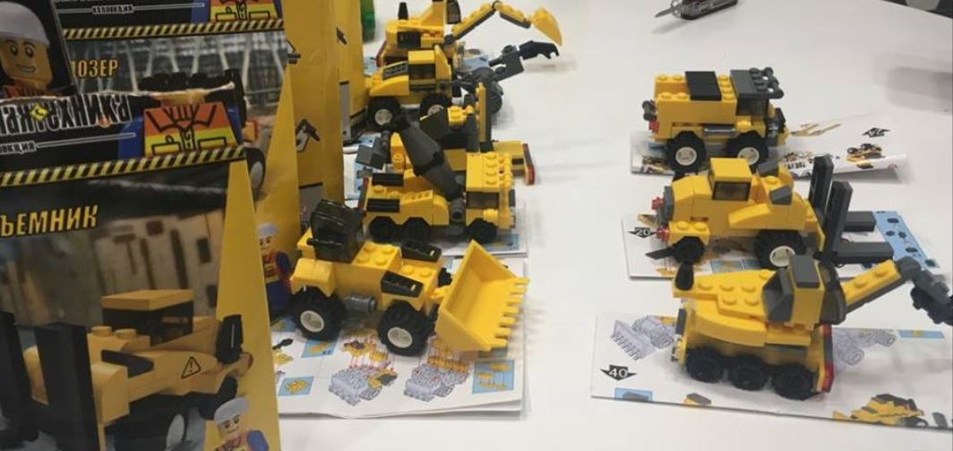
The Experiment
10 LEGO truck models
2 methods
50 dram reward for each
assembled model
Like/dislike assembling
LEGOs
40 participants
2
Notes:
For our experiment we prepared 10 Lego models, which you can see on picture.
Participants have assembled models by two methods, making parallels with real work situations, in this case routine and meaningful work.
We also gave reward for each assembled model, as payment for work
The experiment has three variables as factors… the gender of participant, the method, and we also took like or dislike assembling legos as factor
Each variable has two possible values, so this is 2^k factorial design experiment
In this case we need 40 participants for sample size

Slide 3

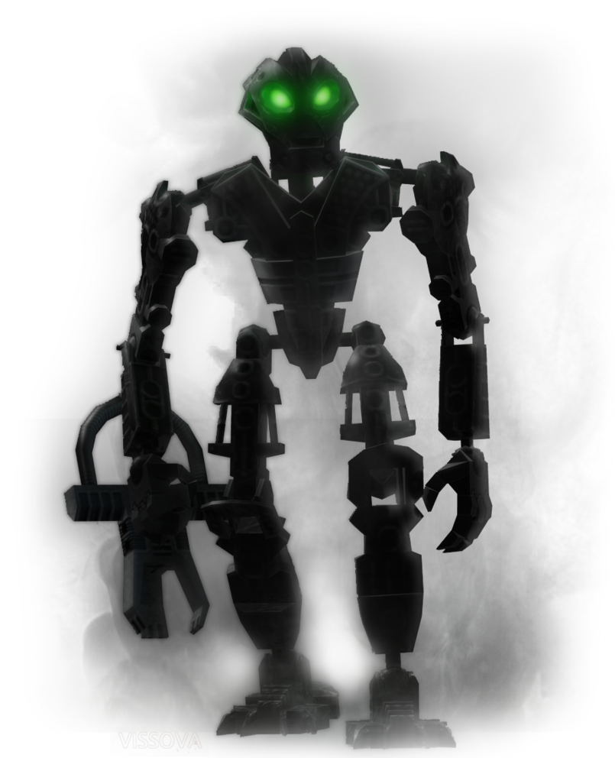
Prehistory
What conditions motivate people at work?
Based on Dan Ariely’s research
Meaningful method
Sisyphus method
Dan Ariely
http://danariely.com
https://www.youtube.com/watch?v=5aH2Ppjpcho
Notes:
The research and experiment are based on american behavioral economist and psychologist Dan Ariely’s experiments to understand which extrinsic factors motivate workers and which do the opposite. This was done by ordering students to assemble lego models. First method is the meaningful one
In this experiment participants were given a Lego Bionicle. They were offered some money to assemble it. The conductor of the experiment took the assembled Bionicle and put it under the table. He asked whether the participant wants to build another one. They were offered the same deal so on, till they gave up.
Second is the Sisyphic
This version of the experiment worked the exact same way, only that assembled Bionicles were not stored under the table but dis-assembled right in front of the eyes
of the participant. This is similar to routine endless work in offices..

Slide 4
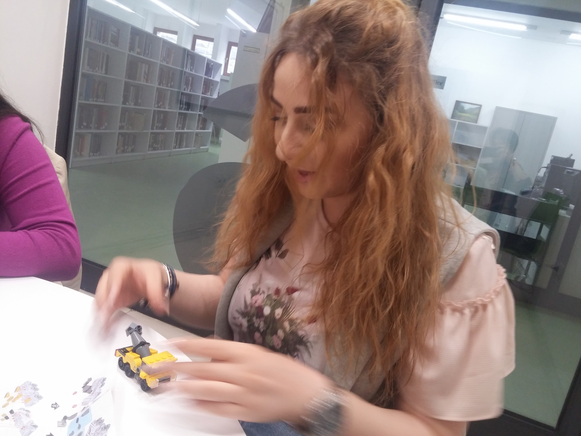
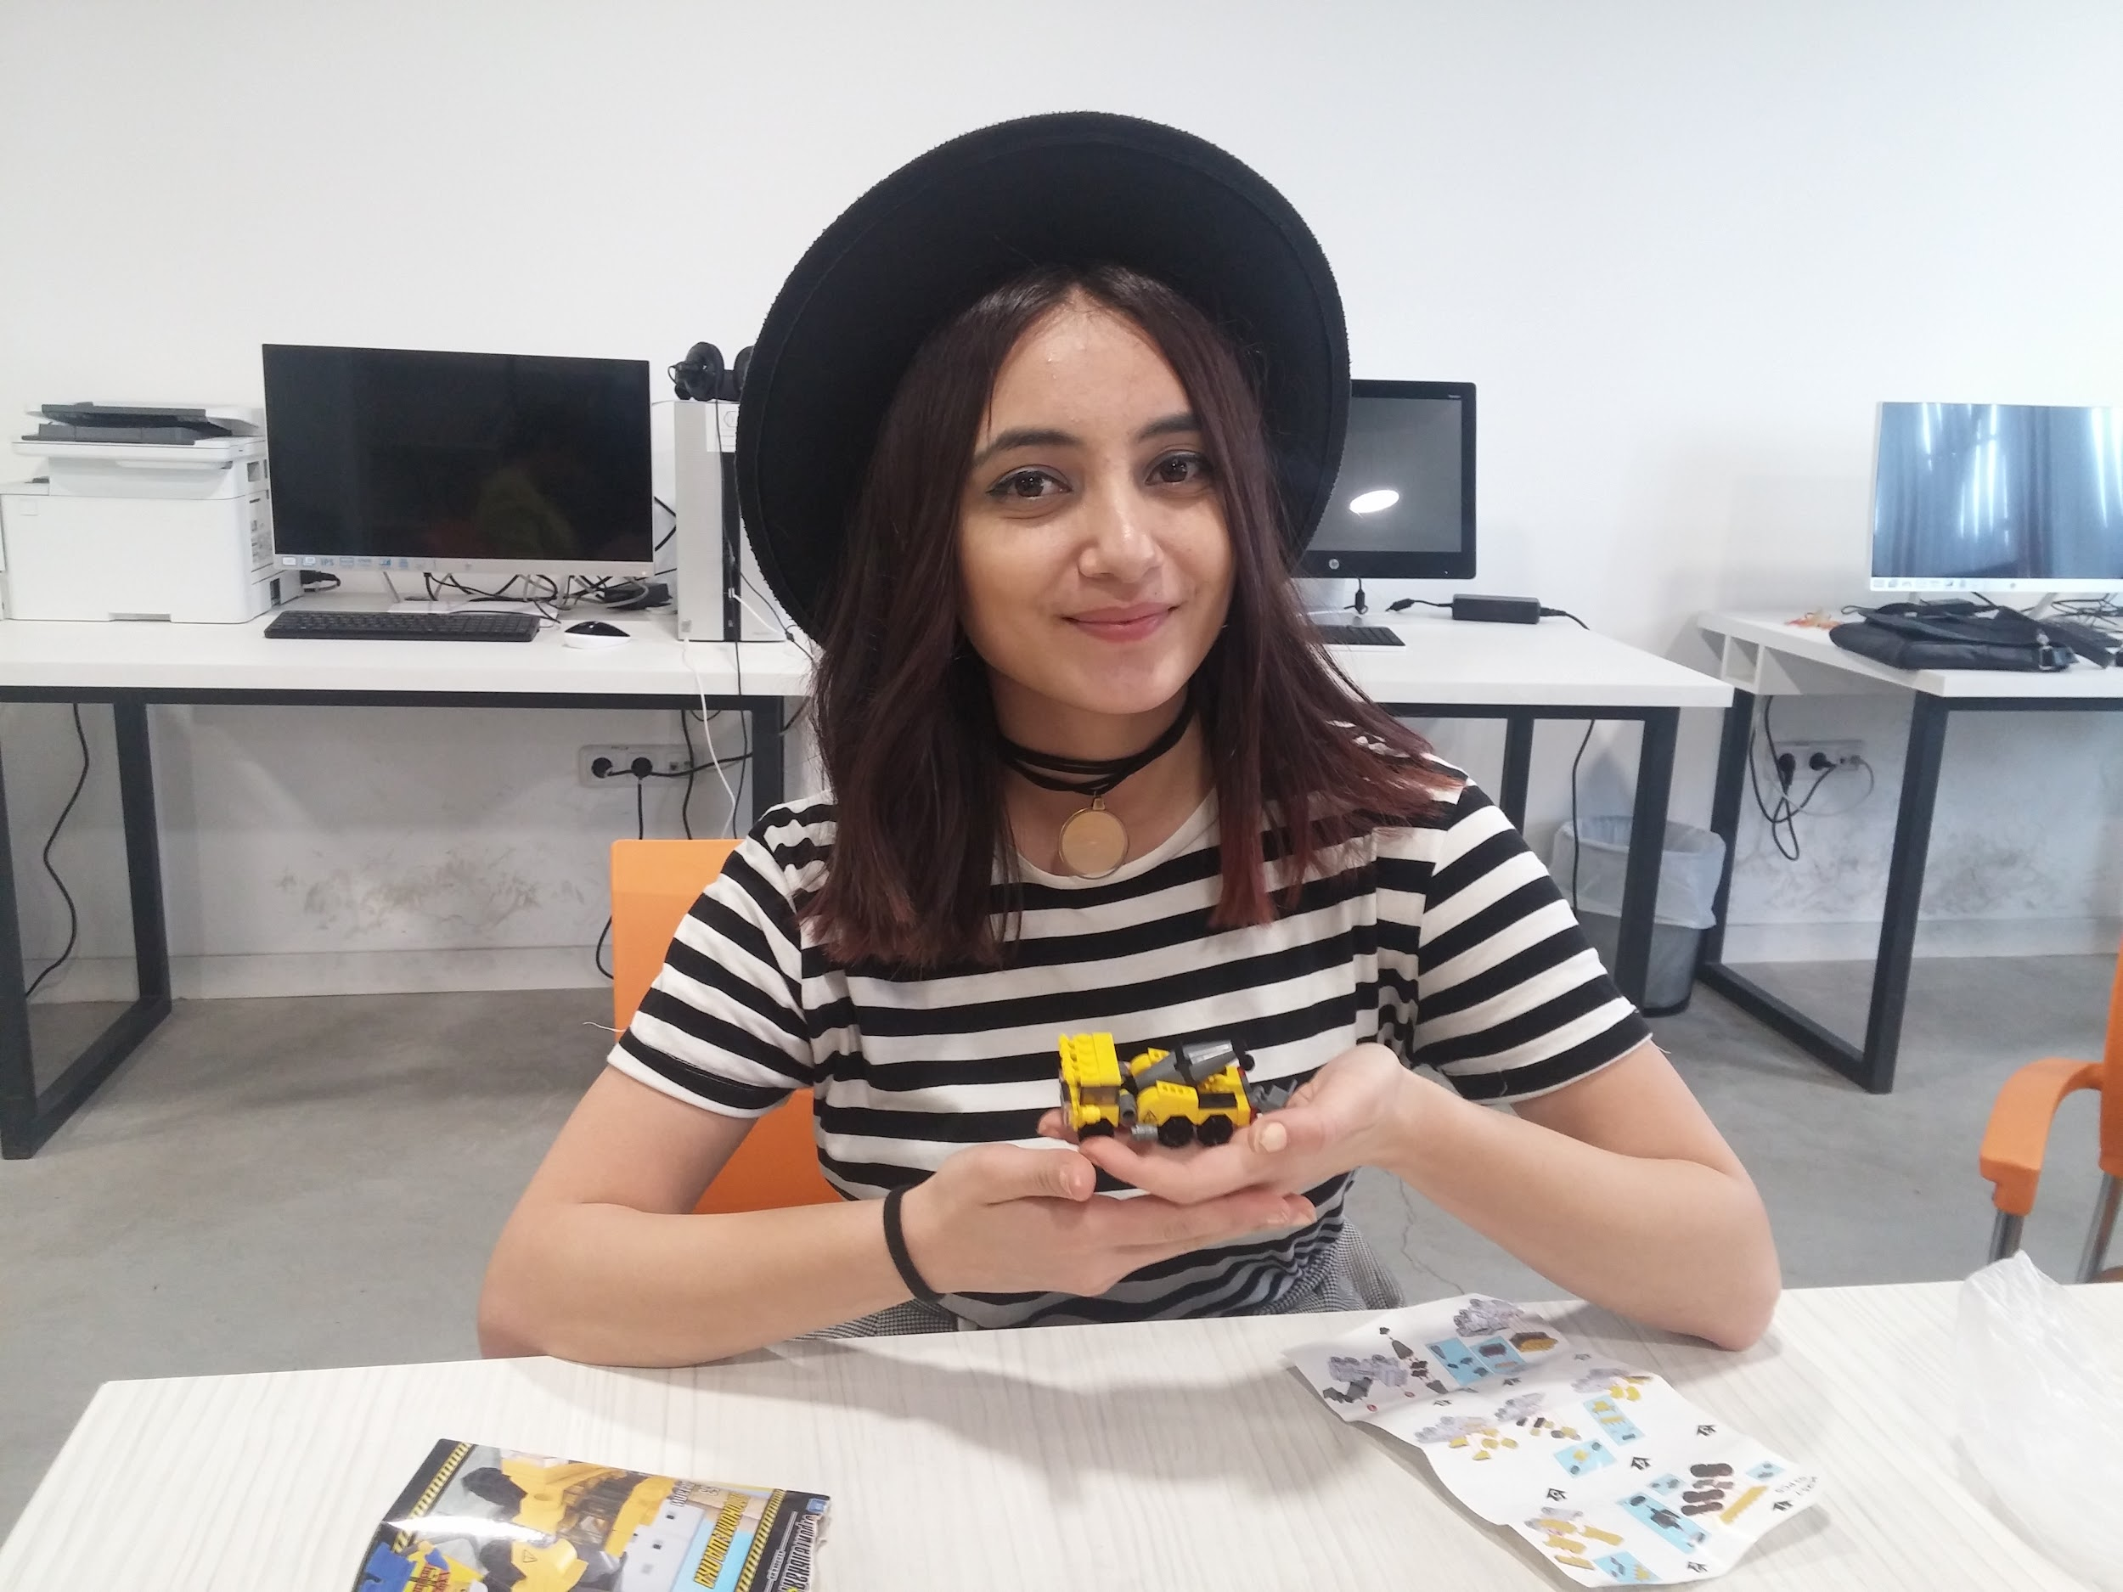
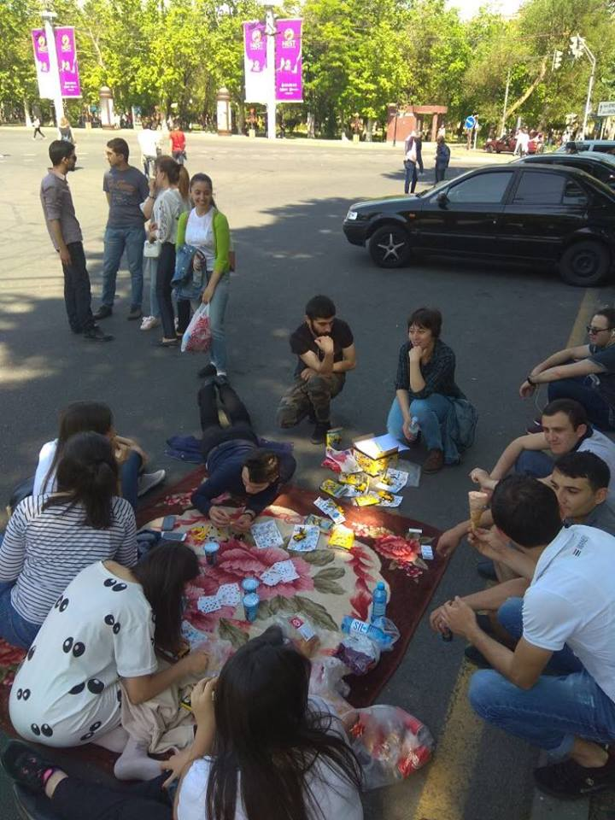
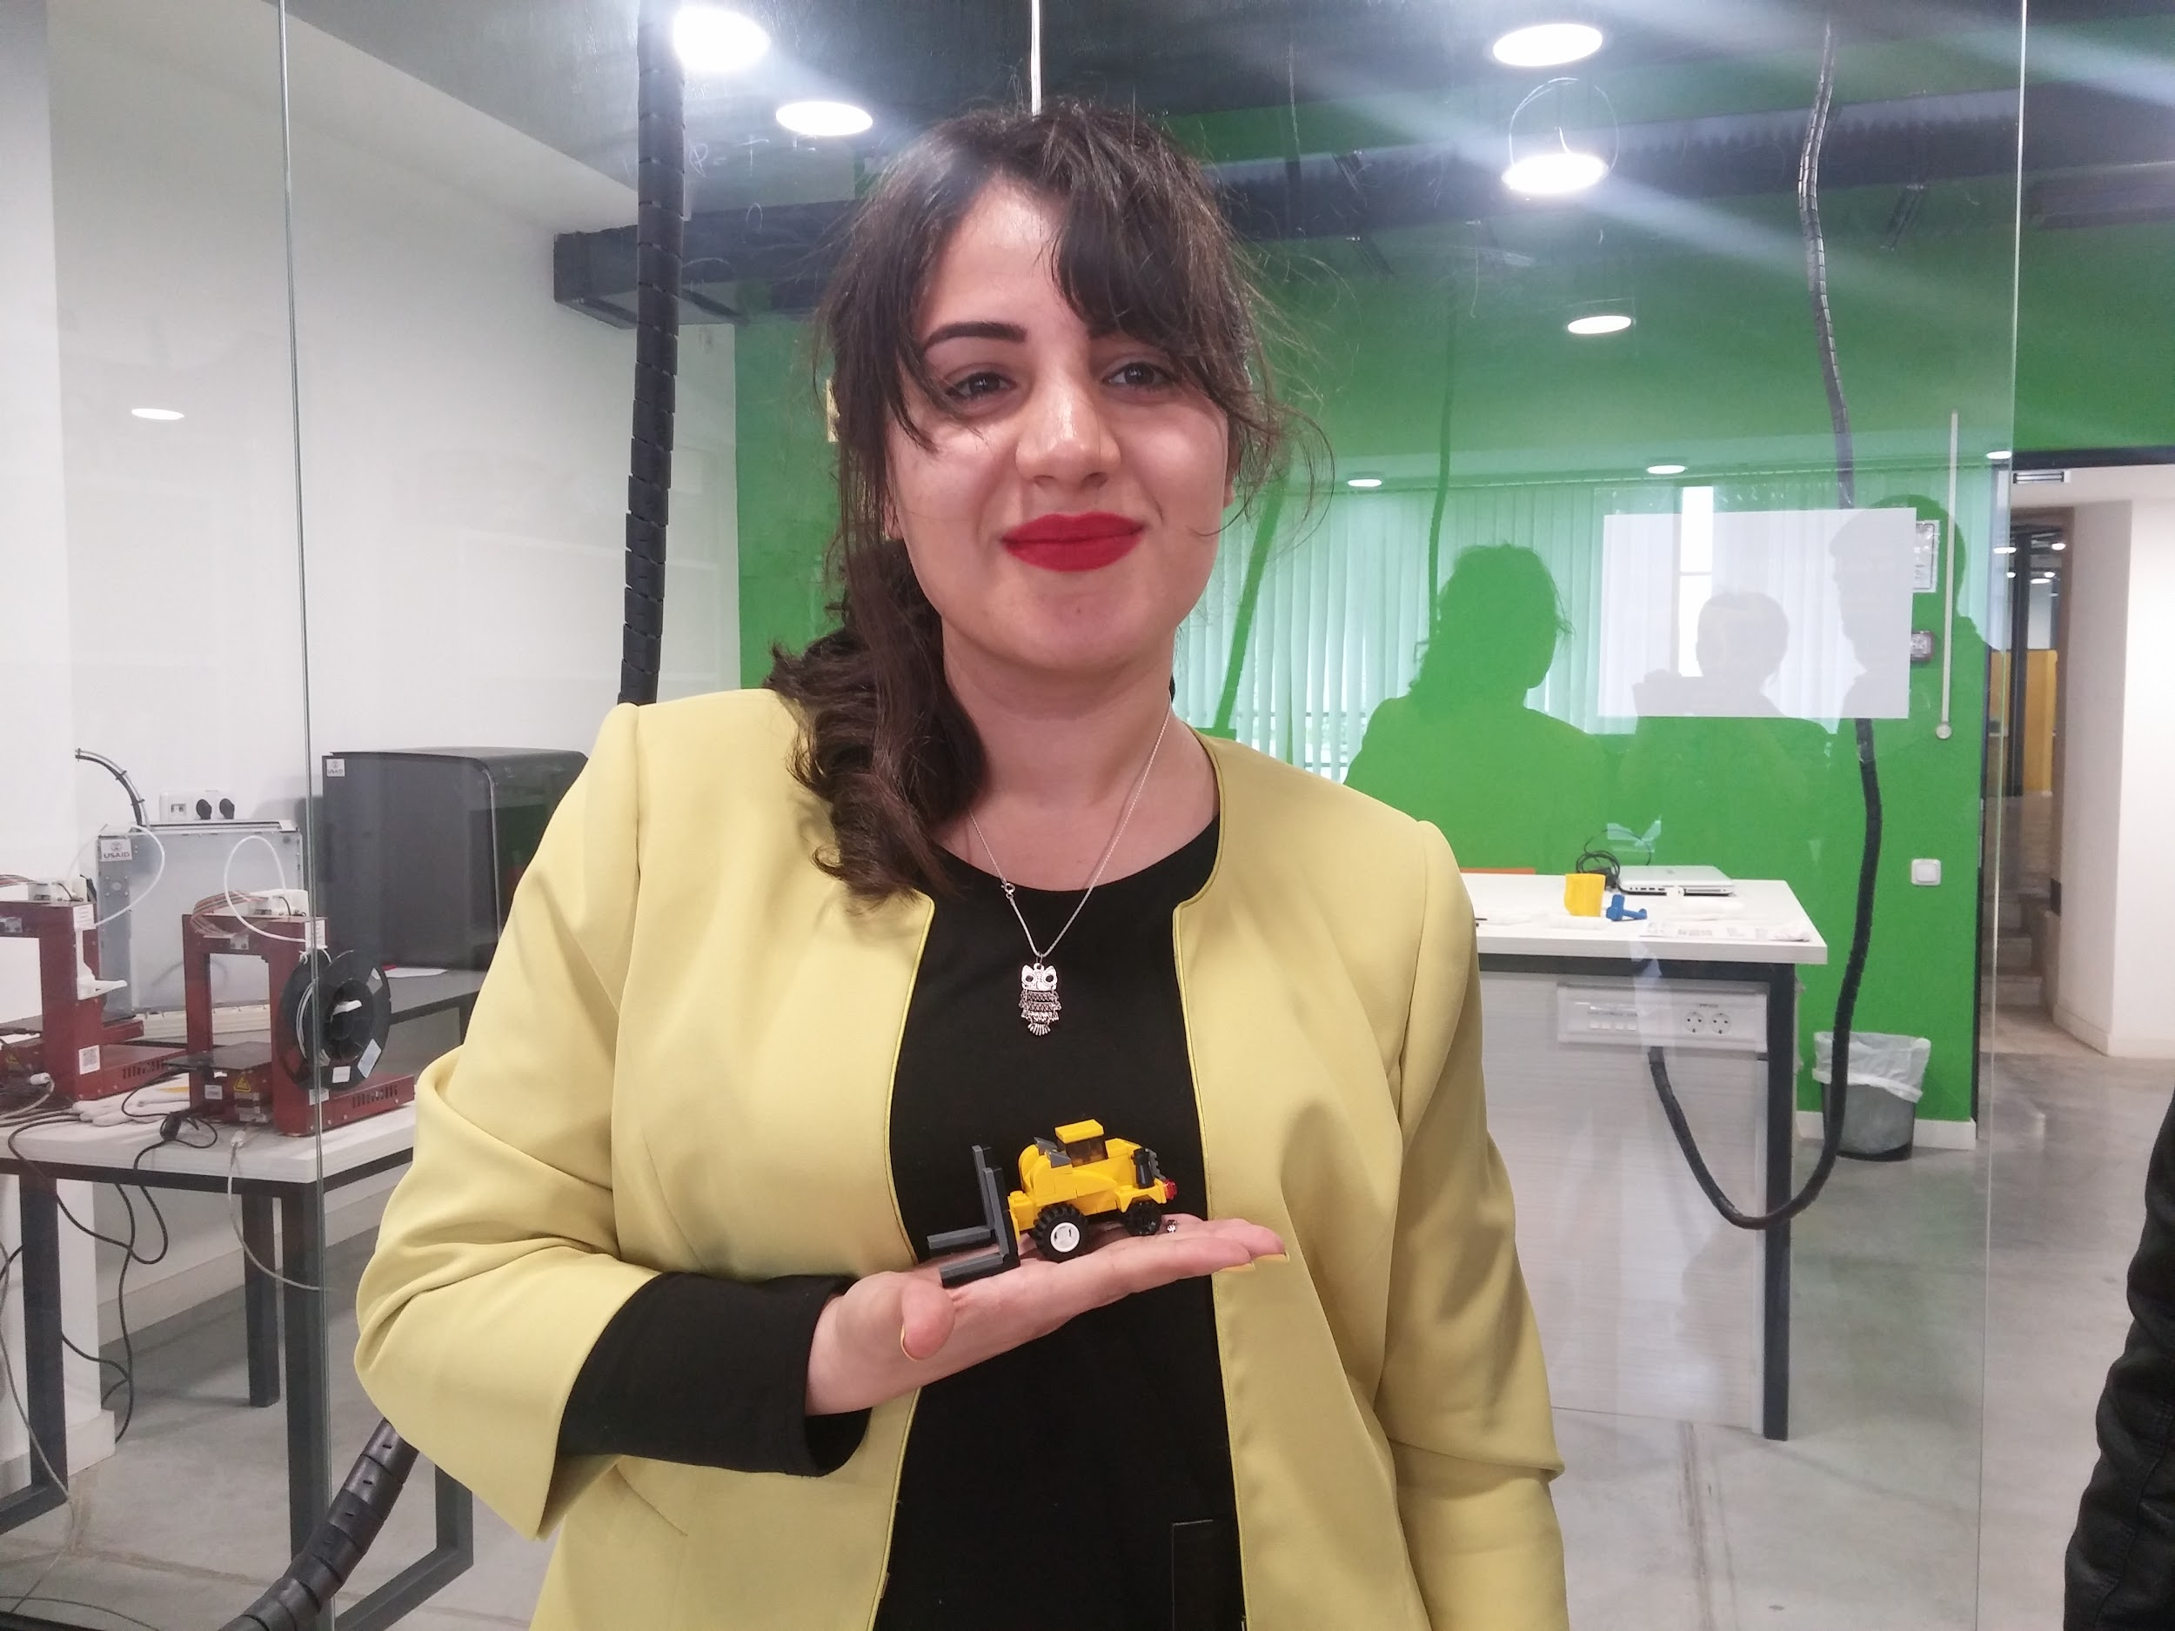
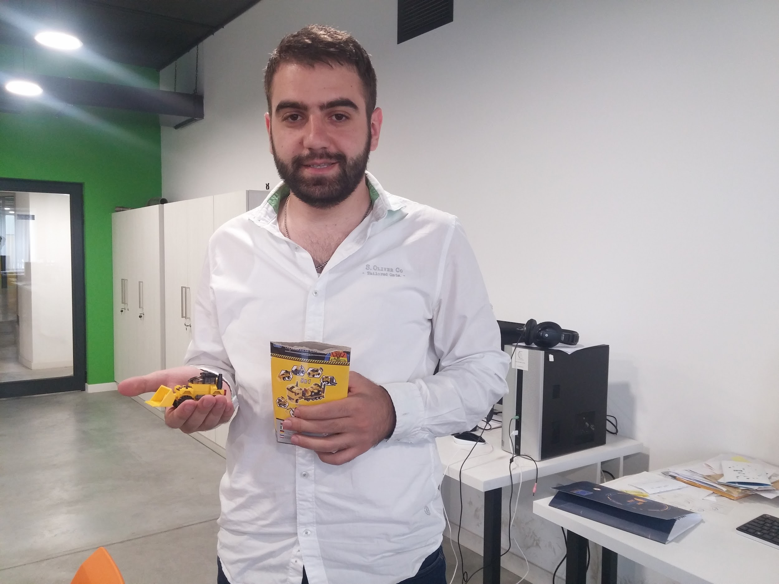
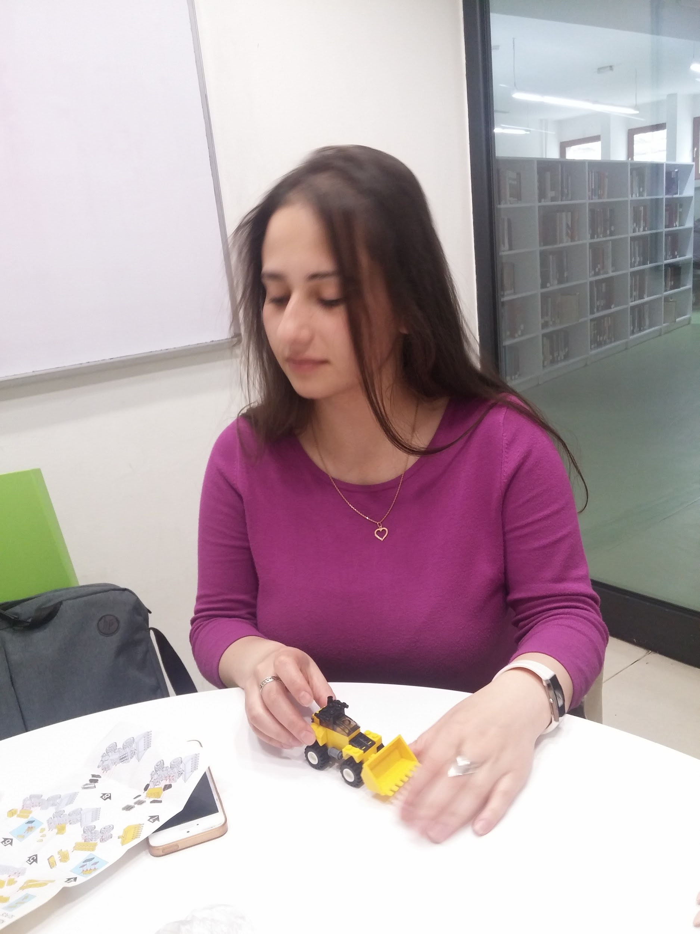
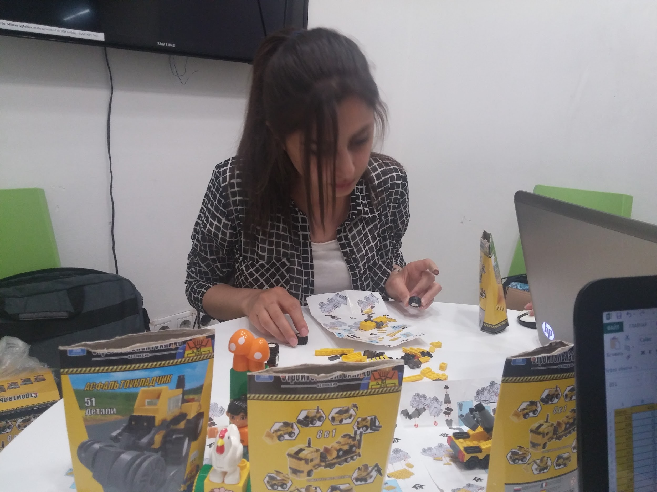
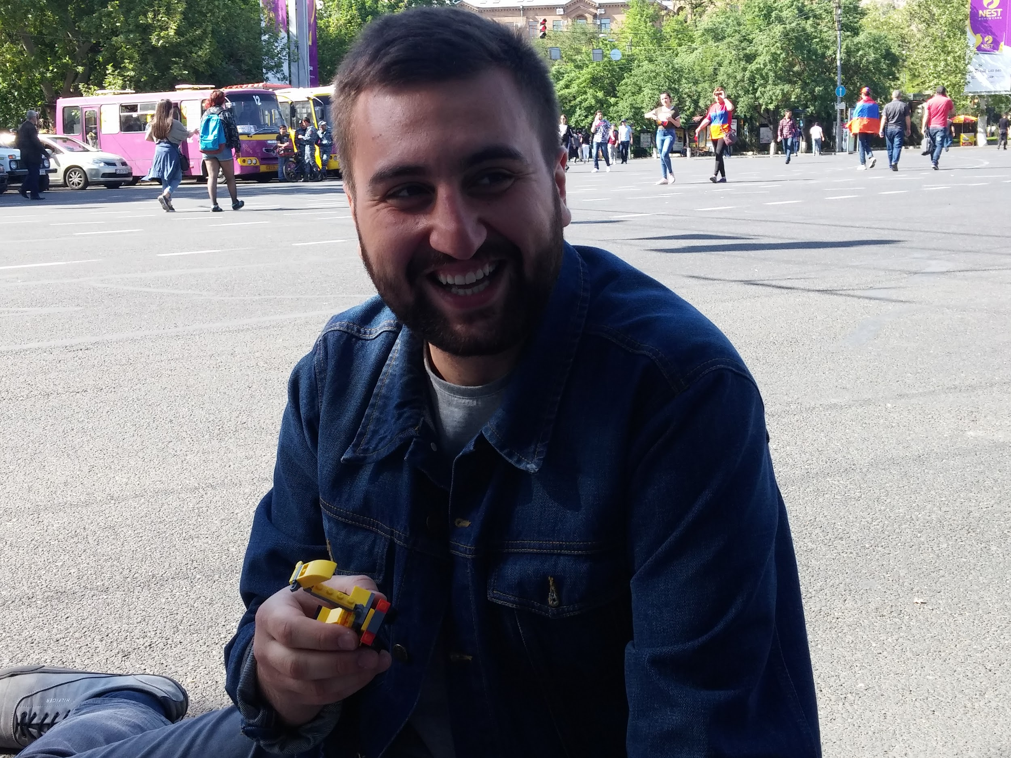
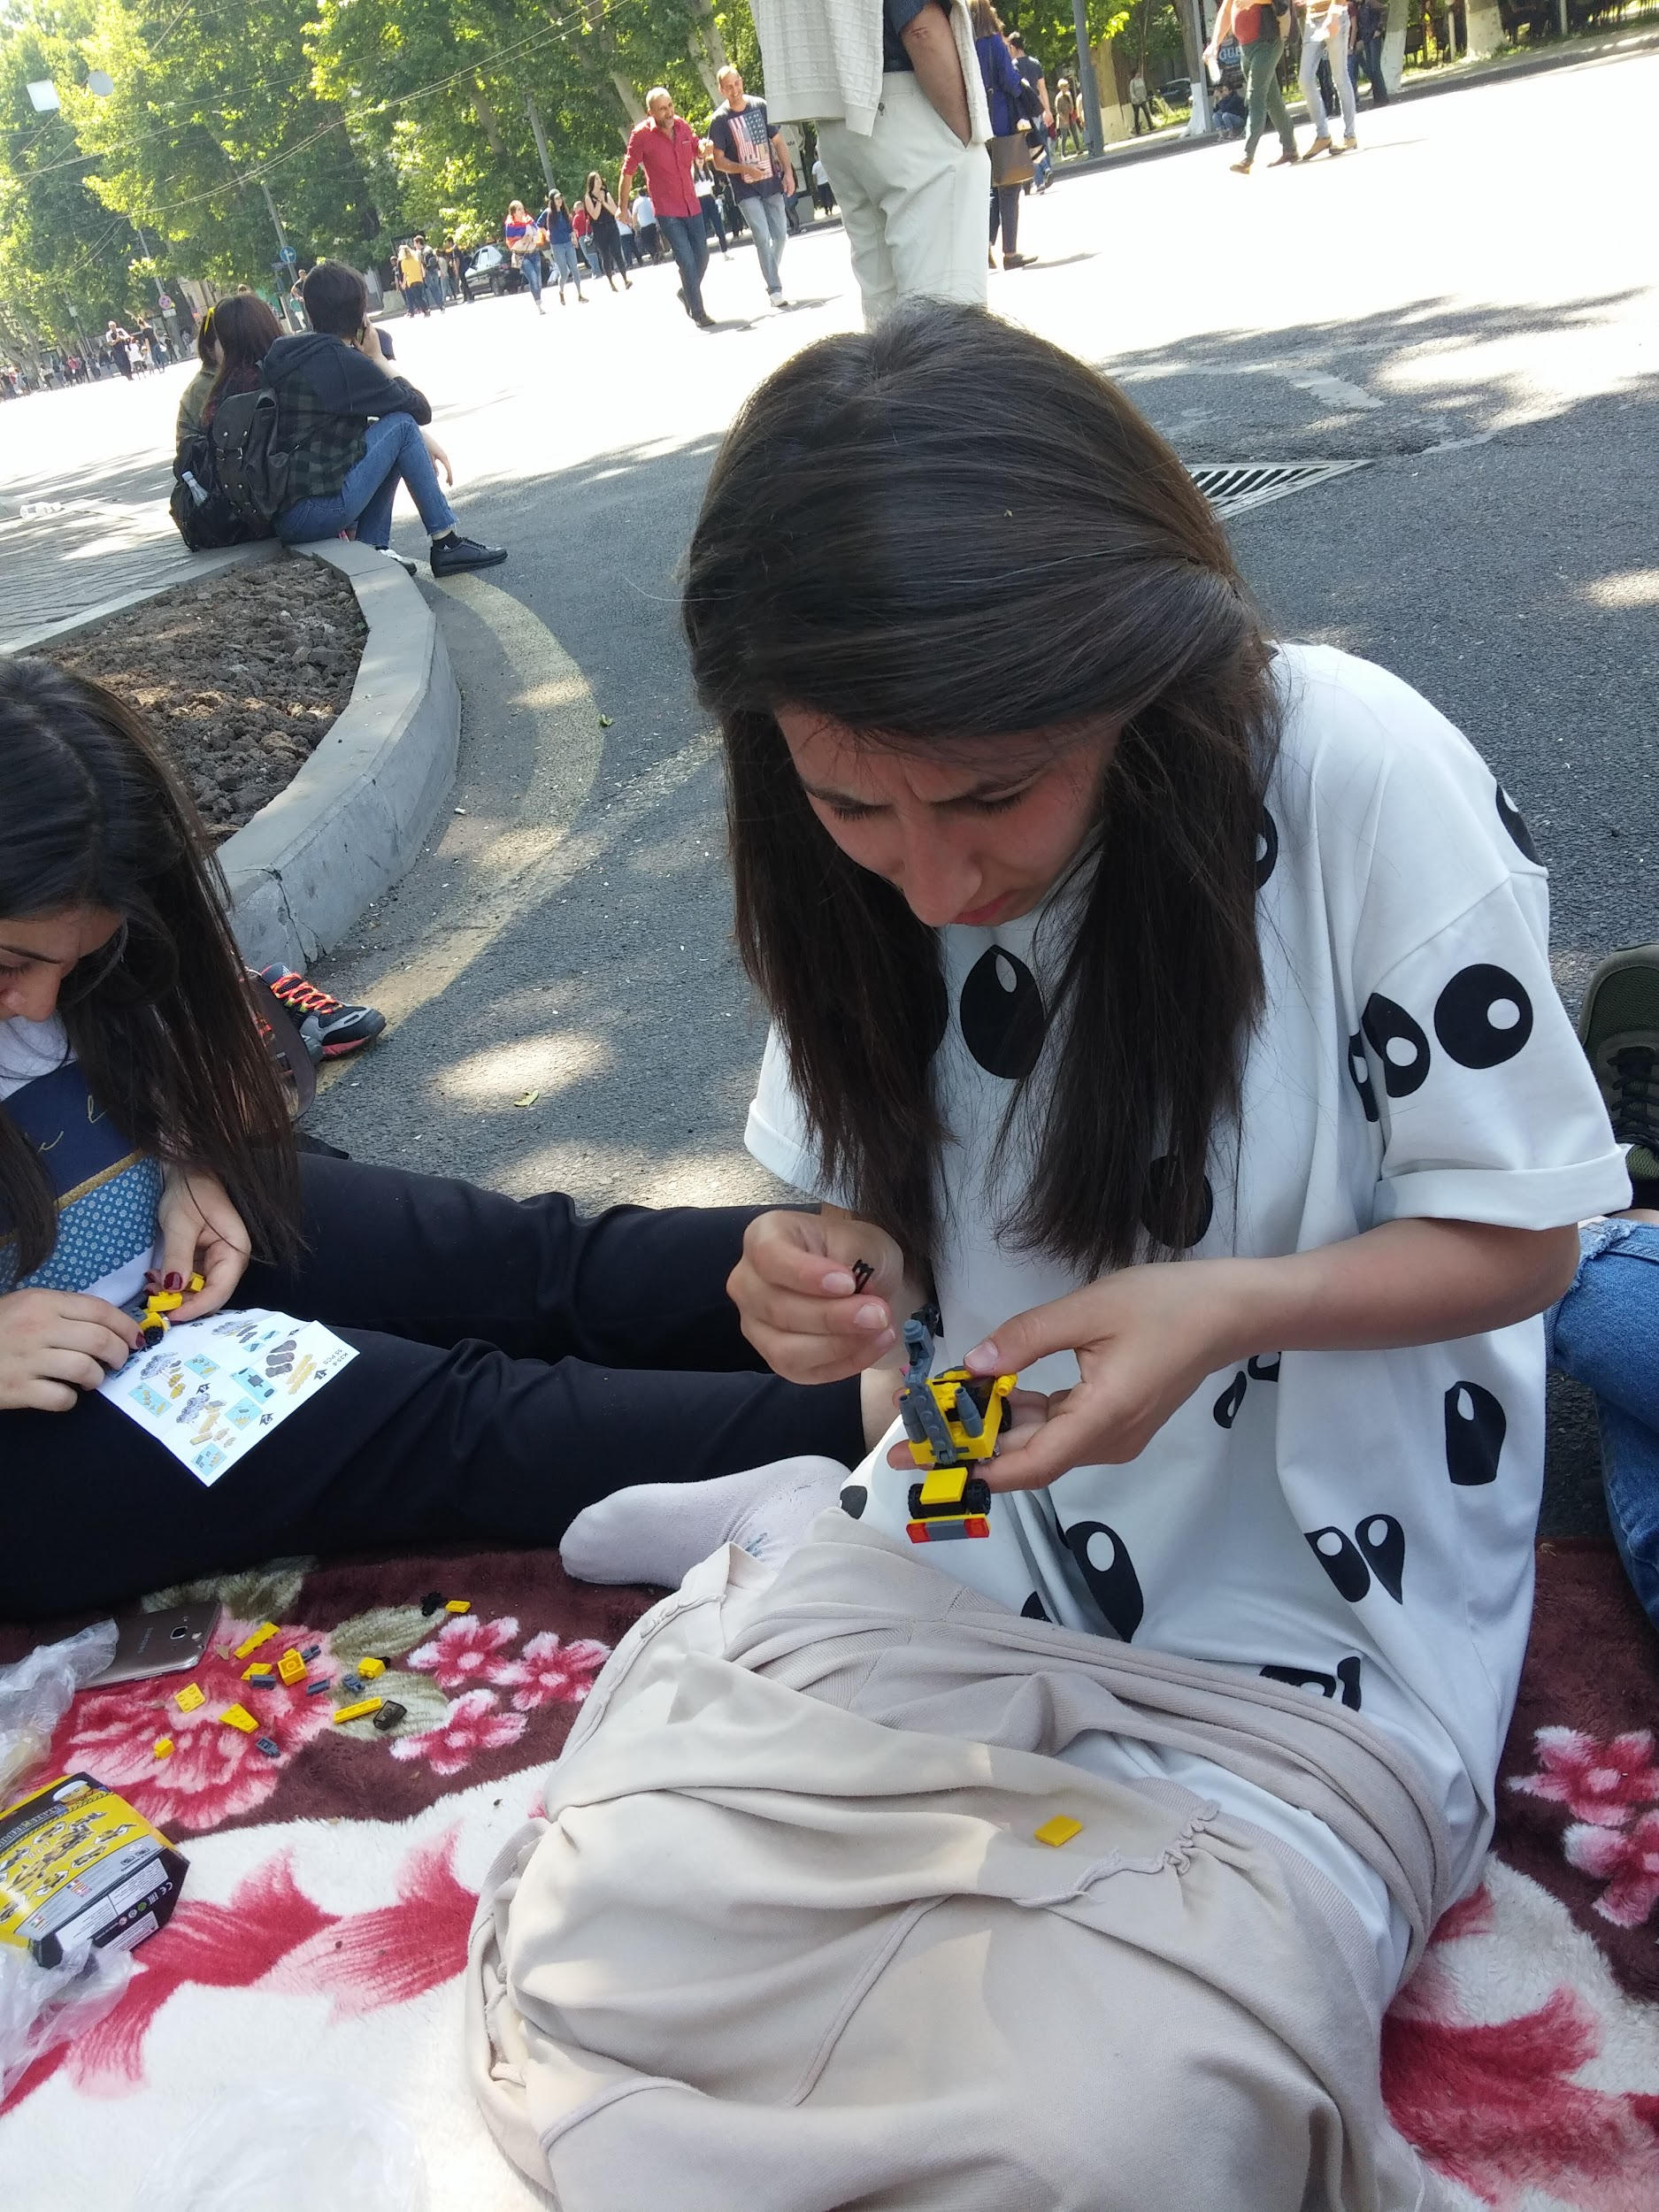
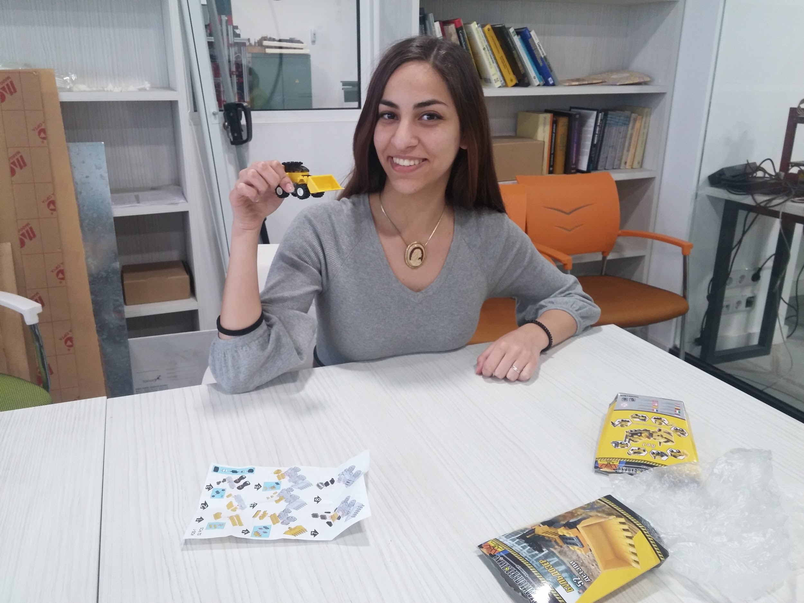
Notes:
We asked 40 people to participate in our survey, using one of the methods while they were assembling the models
As was expected participants who were working with Sisyphus condition were less motivated, and participants who disliked legos, assembled much less than others

Slide 6
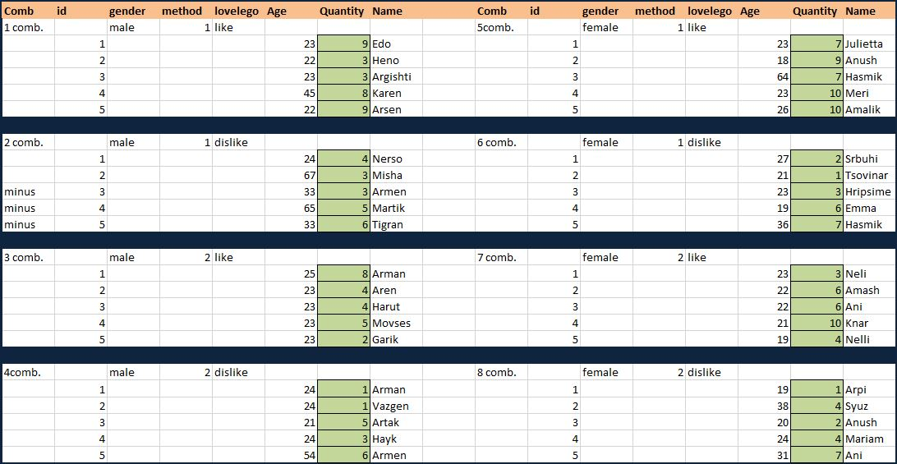
Notes:
This way we collected the required data…

Slide 7
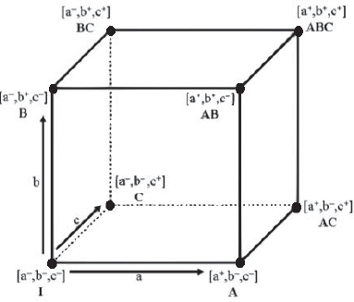
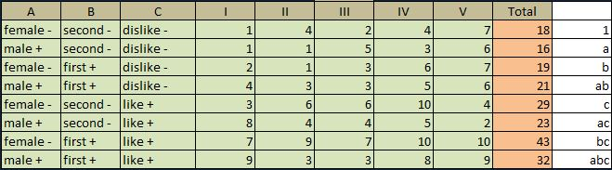
Independent variables Dependent variable
Gender: male, female Quantity: min 1, max 10
Method: assembled, disassembled
Love of Lego: no, yes
Combinations
Notes:
In our experiment we have quantity of assembled legos as dependent variable
Our independent variables are gender of participant, the method of the experiment and sympathy of participant to legos, each with two levels
So we 2*2*2, that is 8 different combinations and 5 experiments for each combination, so our sample size is 40

Slide 8


Main effect for gender(A)
A = (a+ab+ac+abc)/4n-((1)+b+c+bc)/4n = -0.85
This means, that motivation decreases, so in our experiment females are more motivated than males.
Notes:
This means, that motivation decreases, so in our experiment females are more motivated than males.

Slide 9
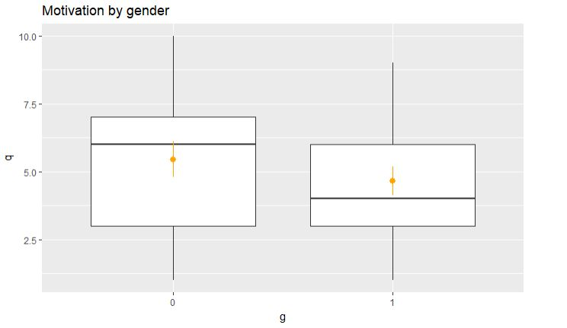

Slide 10
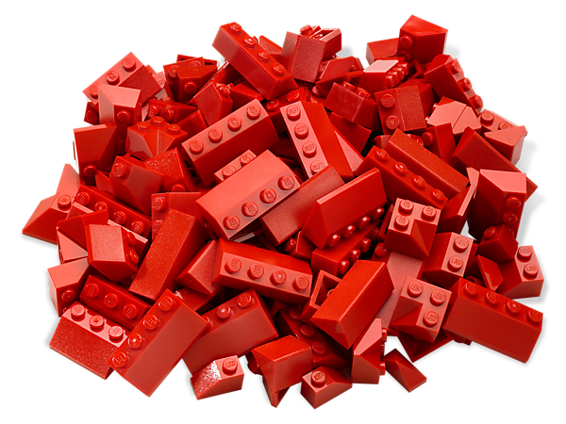
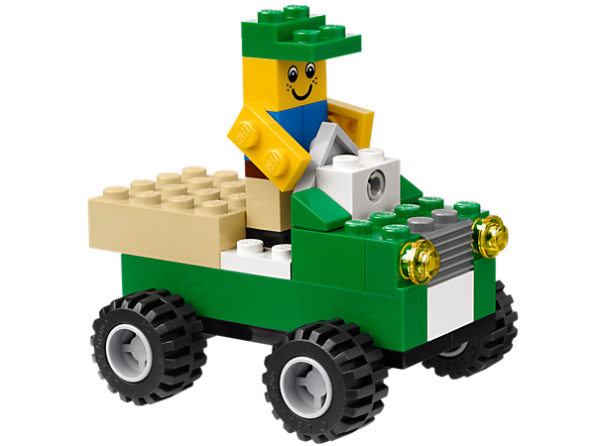
Main effect for method(B)
B = ab+abc+b+bc/4n-((1)+a+b+ac)/4n = 1.95
Motivation increases while using the first method of our experiment, so as Dan Ariely's experiment in our experiments also motivation increases when we keep the legos assembled.
Notes:
motivation increases while using the first method of our experiment, so as Dan Ariel's team discovered in our experimants also motivation increases when we keep the legos assembled.
however the difference is not too essential

Slide 11
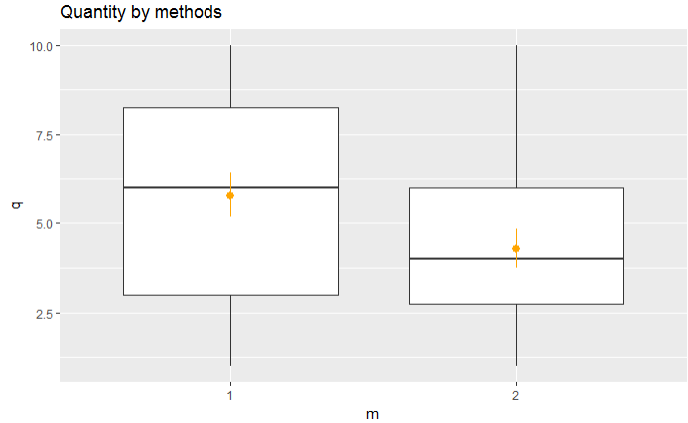

Slide 12

Main effect for love of lego(C)
C = c+ac+bc+abc/4n-((1)+a+b+ab)/4n = 2.65
This factor has the most significant effect on motivation. Those participants who likes legos are more motivated than those who dislikes.
Notes:
So don’t do the job you don’t like)))

Slide 13
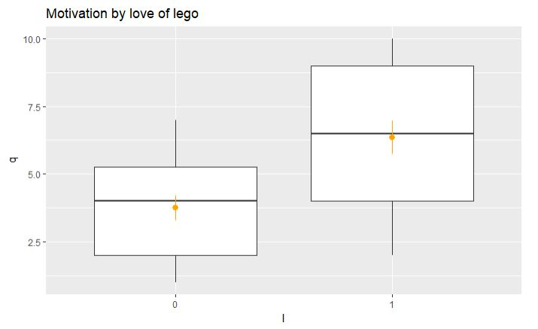

Slide 14
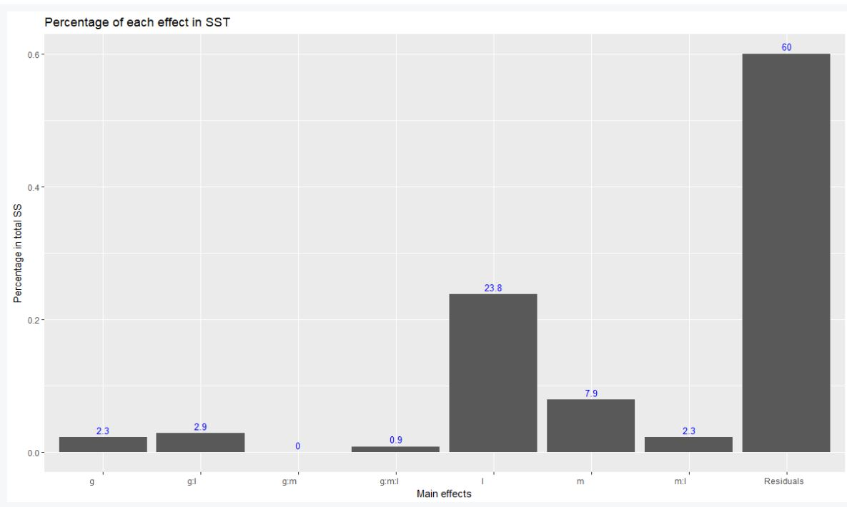
Notes:
#we see the impact of main effects and interactions,
#gender and method interaction is 0, method and lovelego 2.3, our significant main effects are method: 7.9% and lovelego: 23.8%
#also residuals: 60%, that means 60% we will not be able to explain motivation by any of these variables.

Slide 15
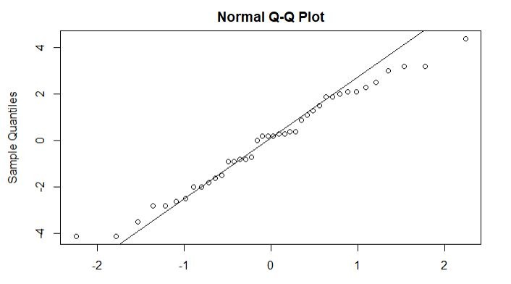
Checking normality
Notes:
points should be near to the line, and it seems like that, but let's also check it by using shapiro test
p.value(0.61)>alpha, so there is no violation of normality assumption. The errors of the model are normally distributed.

Slide 16
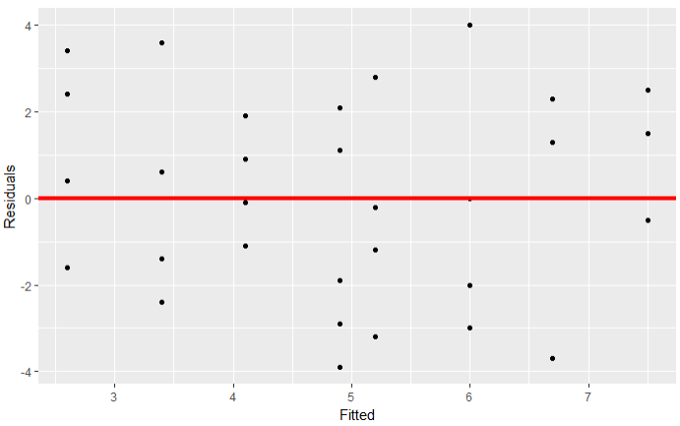
Notes:
#variance assumption is not violated

Slide 17
model<-lm(quantity~gender+method+lovelego, data=project)
summary(model)
Our model does not have
points with high leverage
outlier point
Influential points

Slide 18
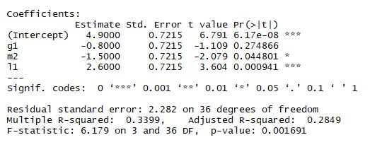
Multiple R-squared: 0.3399
The percentage of the total variation that is explained by the regression is 34%.
F-test: overall our model is significant

Slide 19
Thank You!
Questions?!
Notes:
© Copyright Showeet.com

